Slide 1

Streamline.inc
The hack

Slide 2

Objectives for Our Source code
Implementation of cards
GUI Interaction

Slide 3
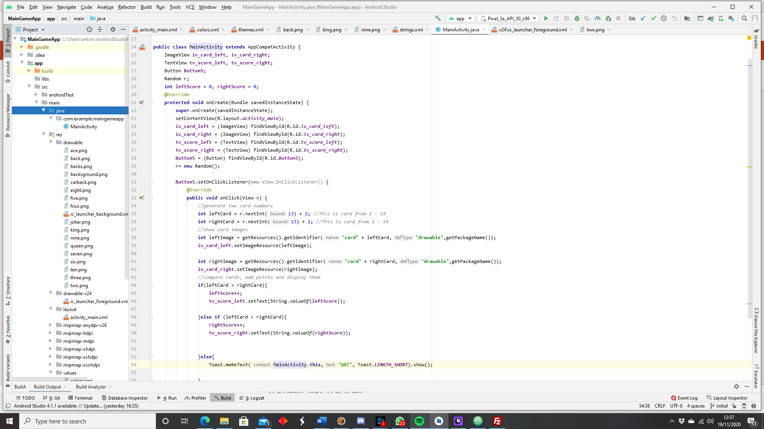
The main

Slide 4
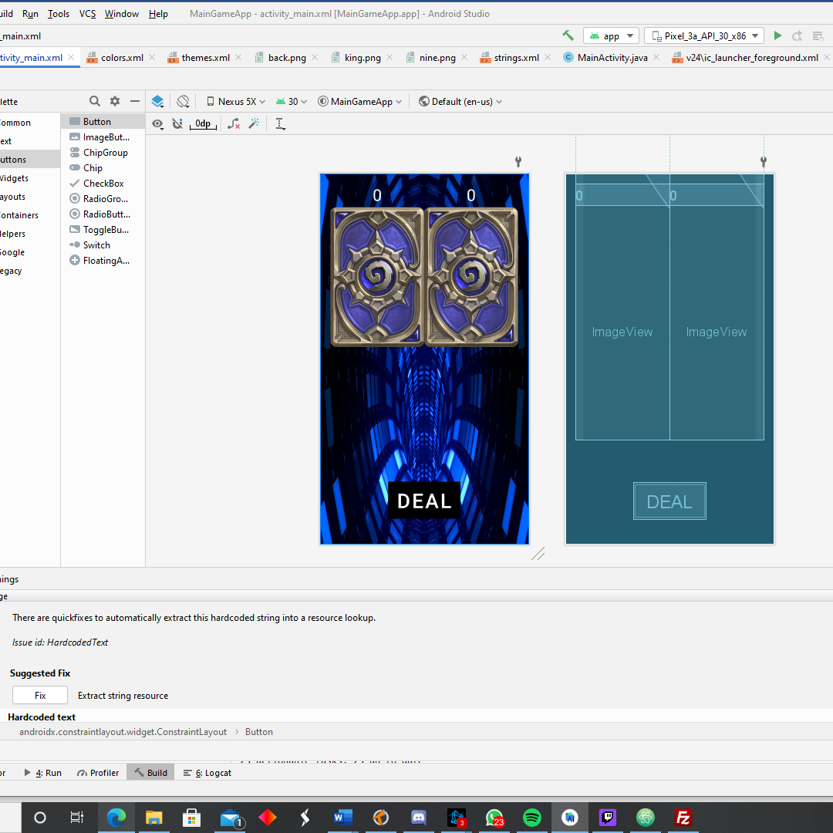
Design UML
Testing at a small level how cards can be seen from a tablet and phone.
Testing what images would be suitable for our game

Slide 5
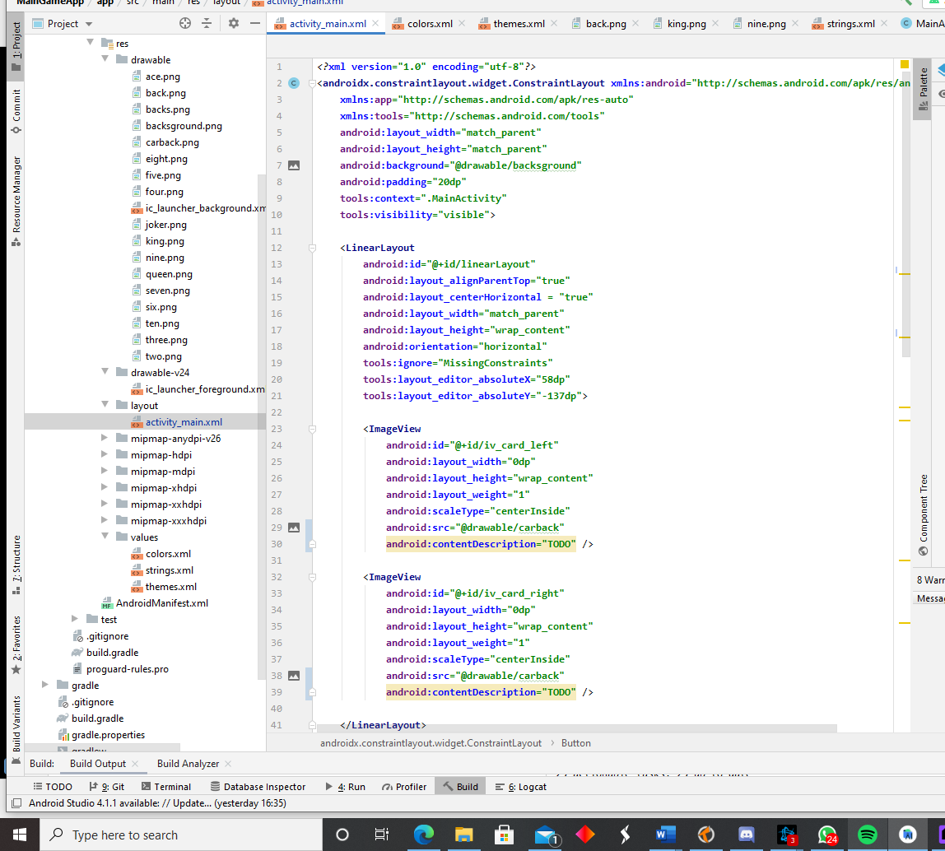
Challenges Ahead

Slide 6
Thank you!

